Slide 1

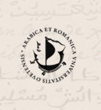
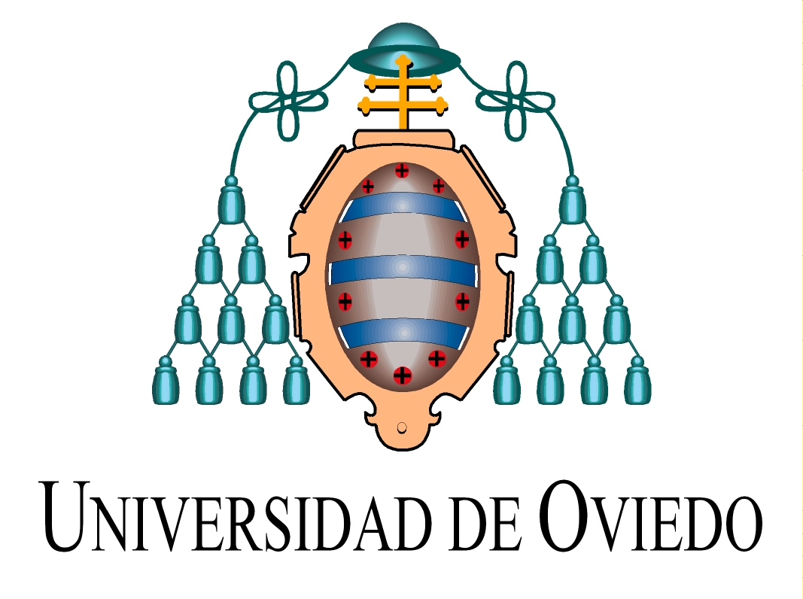
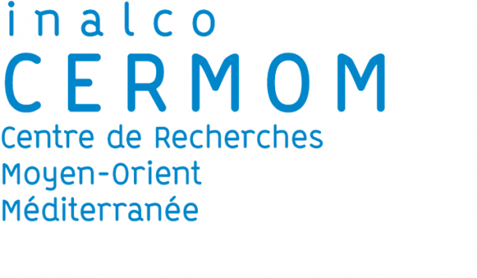

Prácticas islámicas entre los moriscos: en torno a un relato del ḥaǧǧ
Pablo Roza Candás
SEAR - Oviedo / CERMOM - Paris

Slide 2
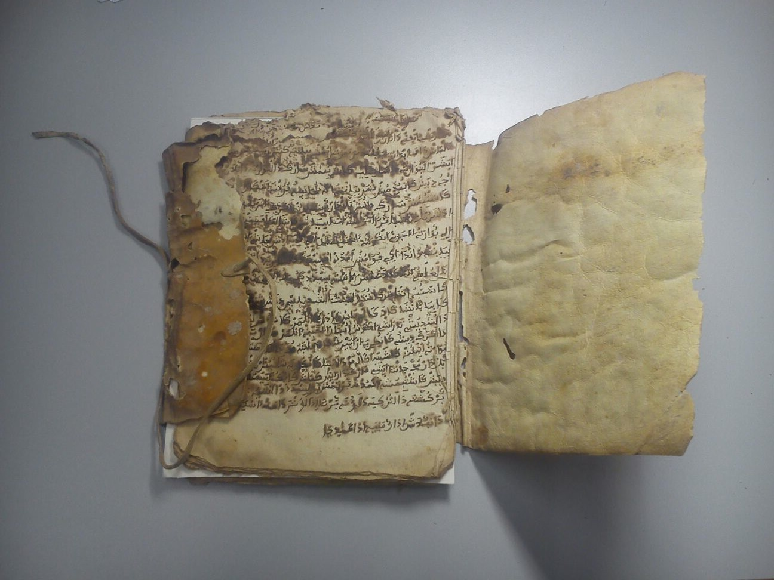
Ms. L 771-4, Fondo Documental Histórico de las Cortes de Aragón, Zaragoza

Slide 3
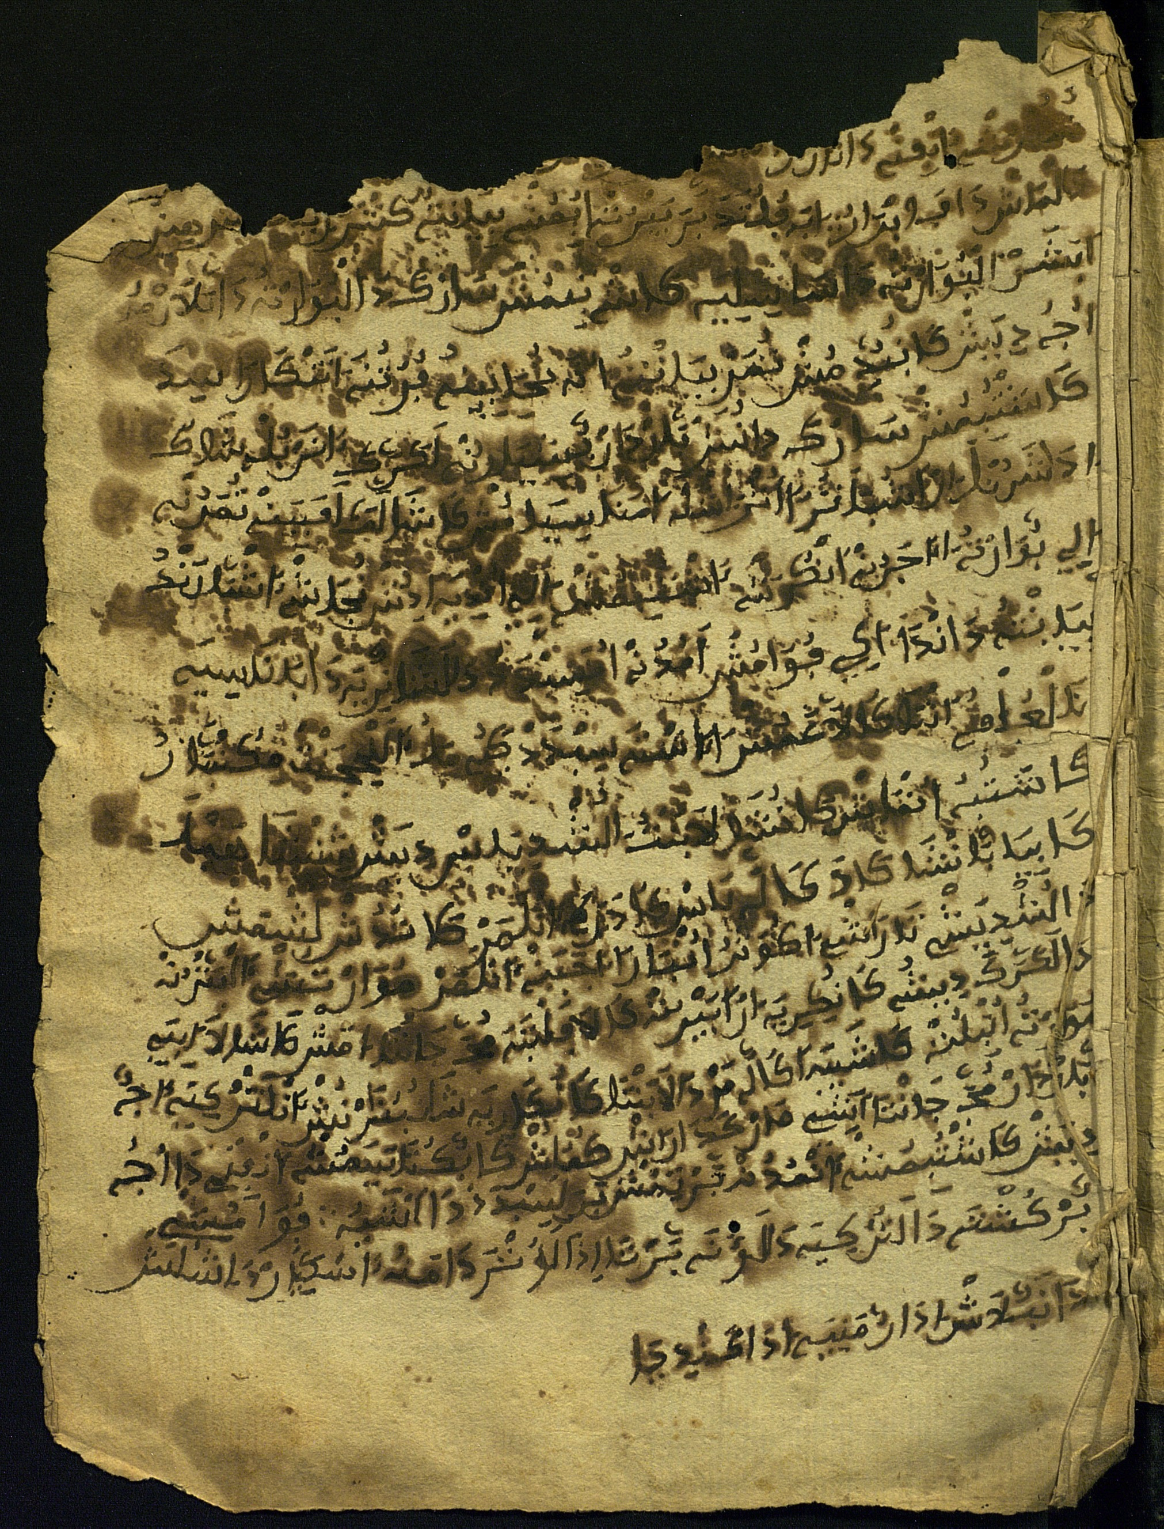
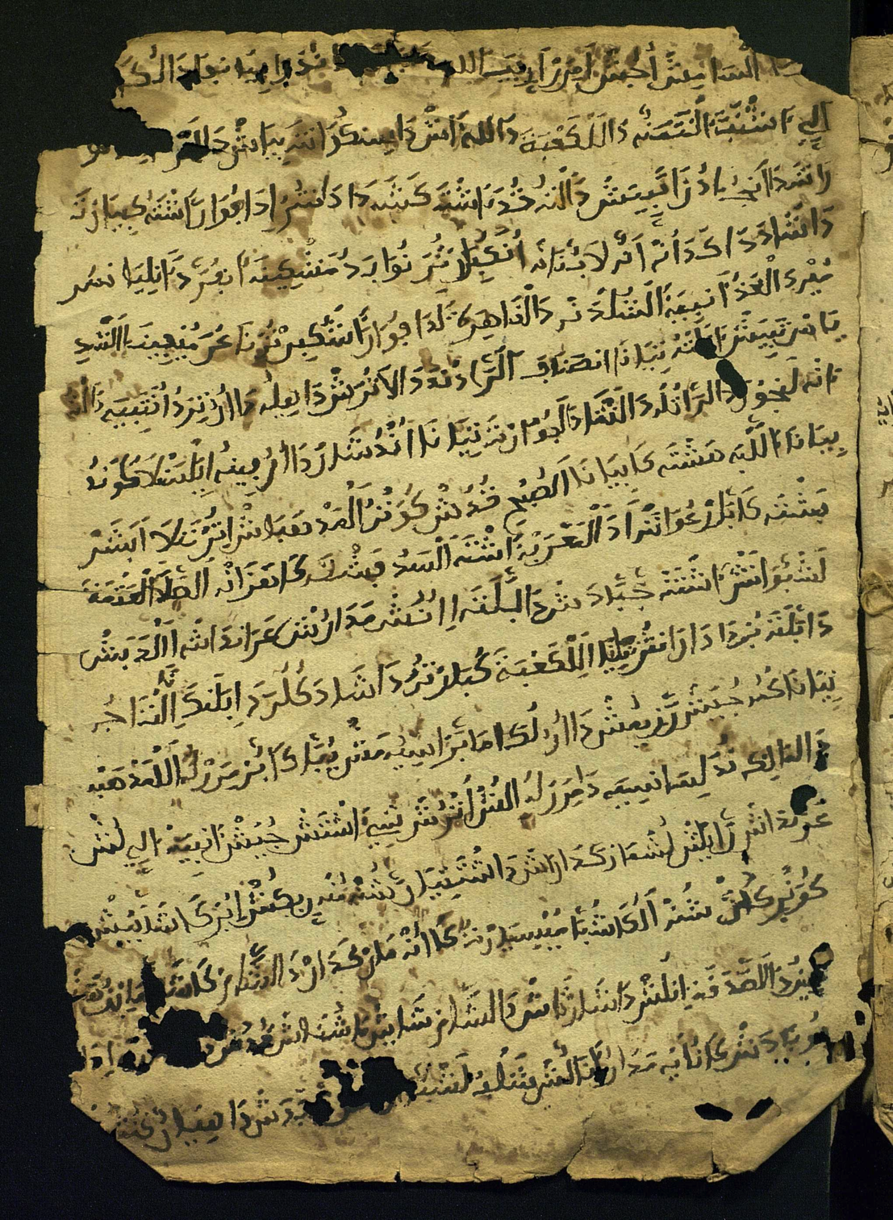
Ms. L 771-4, Fondo Documental Histórico de las Cortes de Aragón, Zaragoza, fols. 1r y 14r

Slide 4
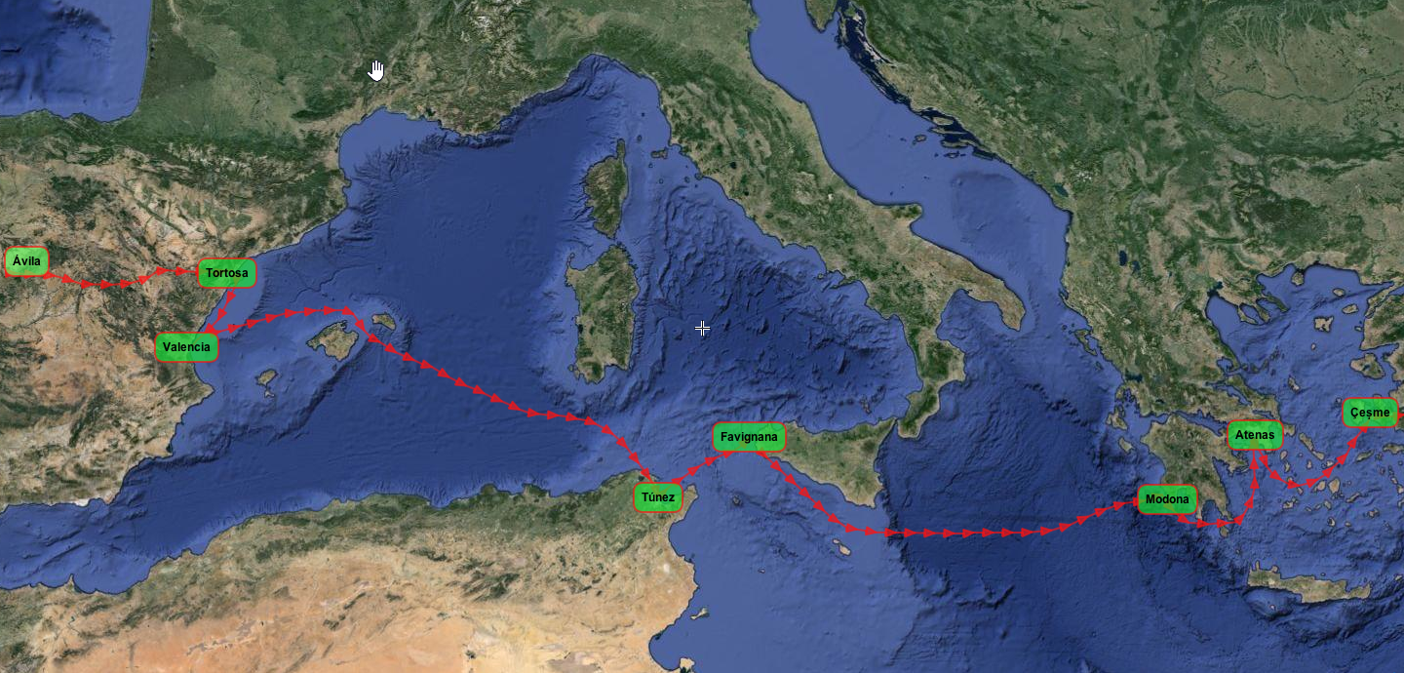

Slide 5
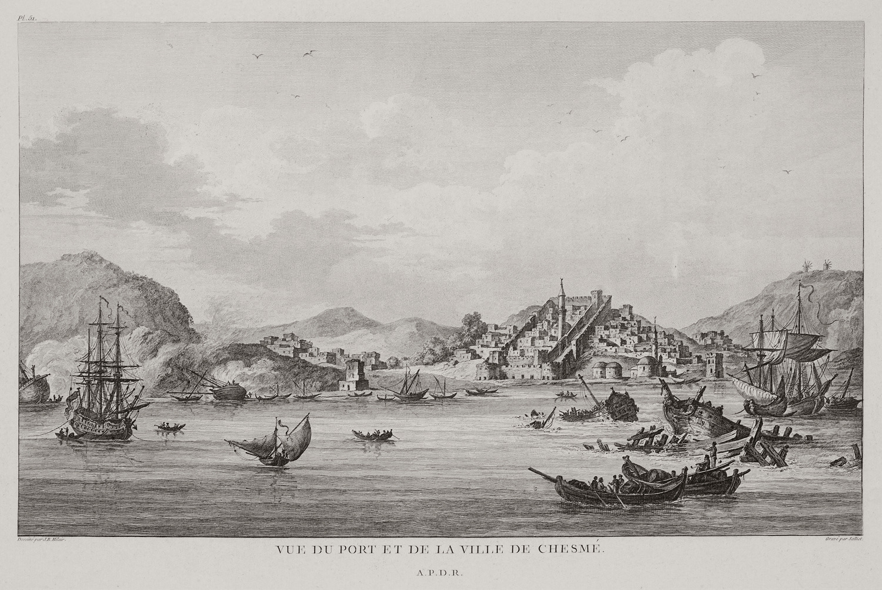
[Çeşme]
Jean Baptiste Hilair
Aikaterini Laskaridis Fondation Library

Slide 6
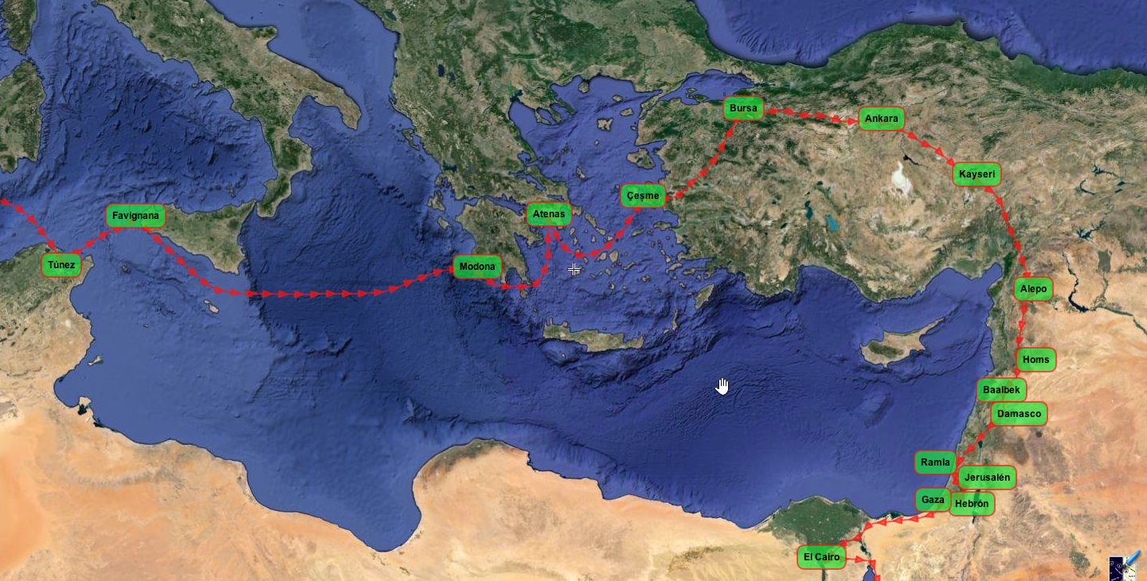

Slide 7
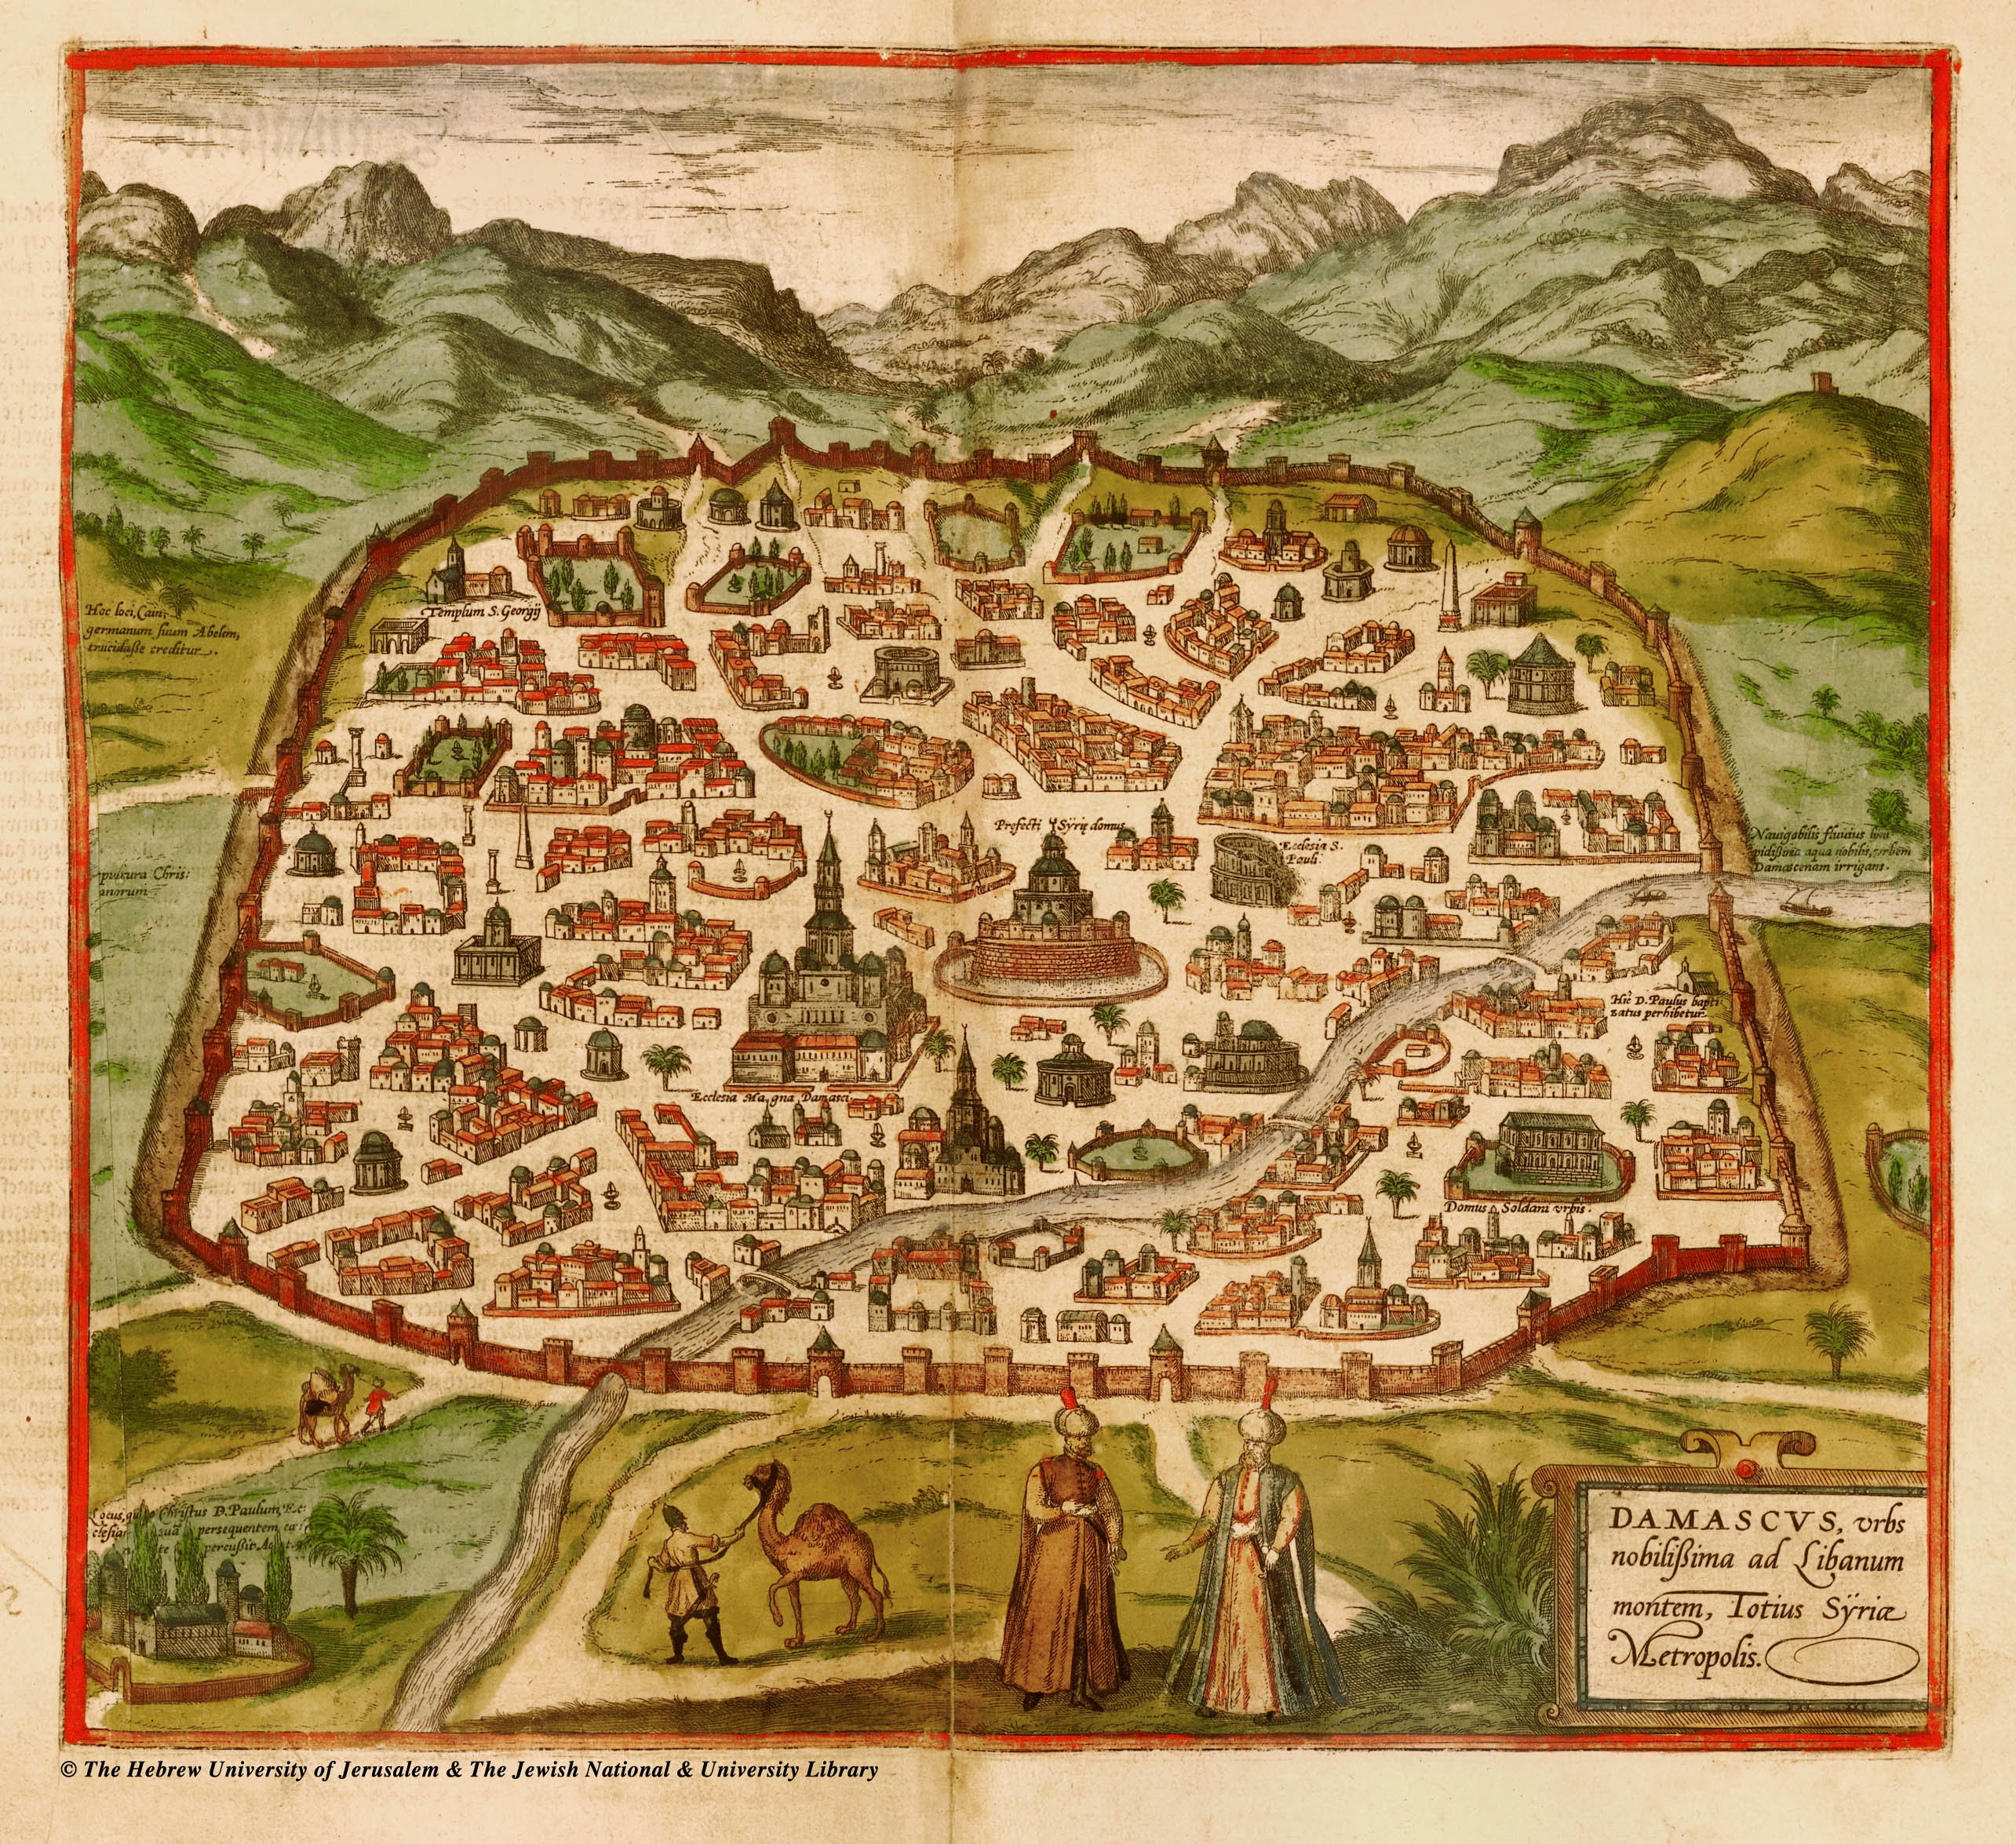
[Damasco]
Braun & Hogenberg, Civitates Orbis Terrarum (1575)
Historic Cities Center, Hebrew University of Jerusalem

Slide 8
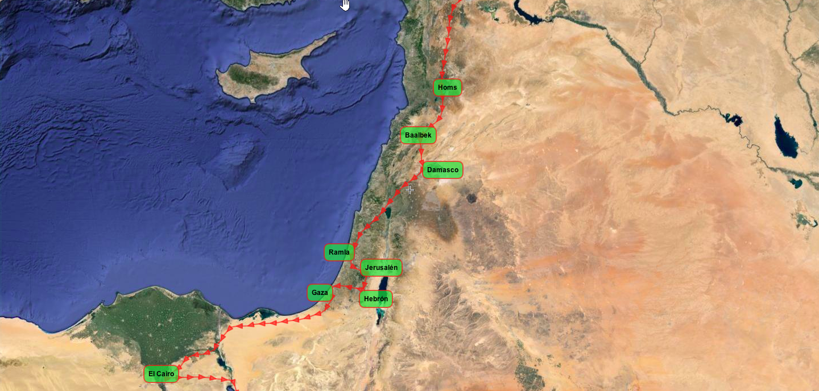

Slide 9
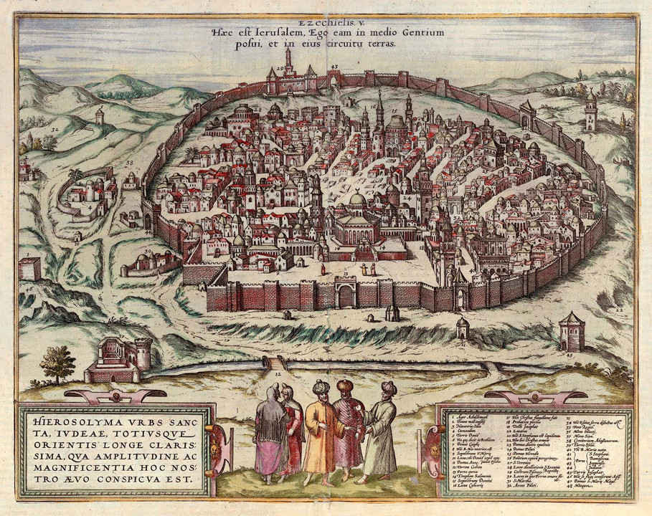
[Jerusalén]
Georg Braun - Frans Hogenberg (1560)
Historic Cities Center, Hebrew University of Jerusalem

Slide 10
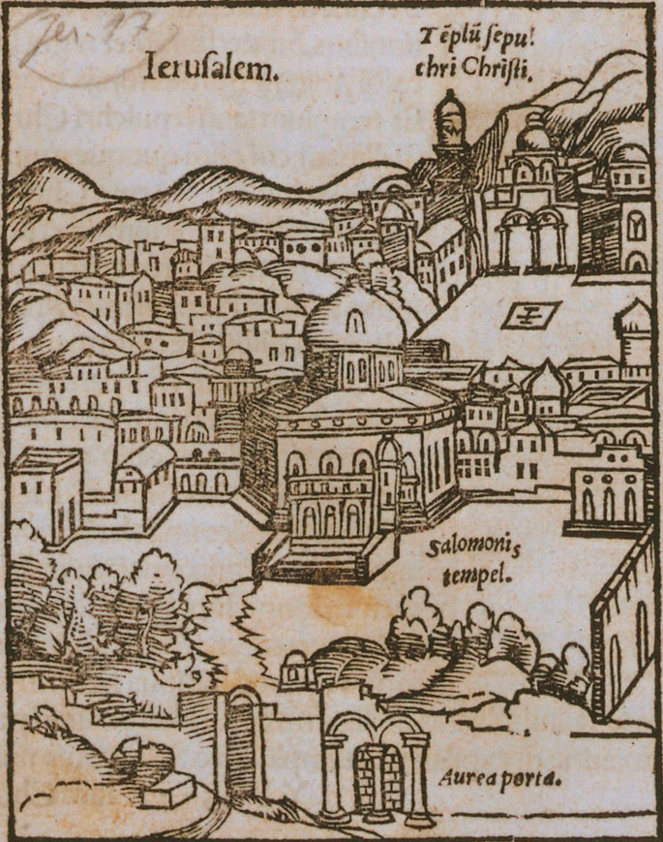
[Jerusalén]
Sebastian Münster (1550)
Historic Cities Center, Hebrew University of Jerusalem

Slide 11
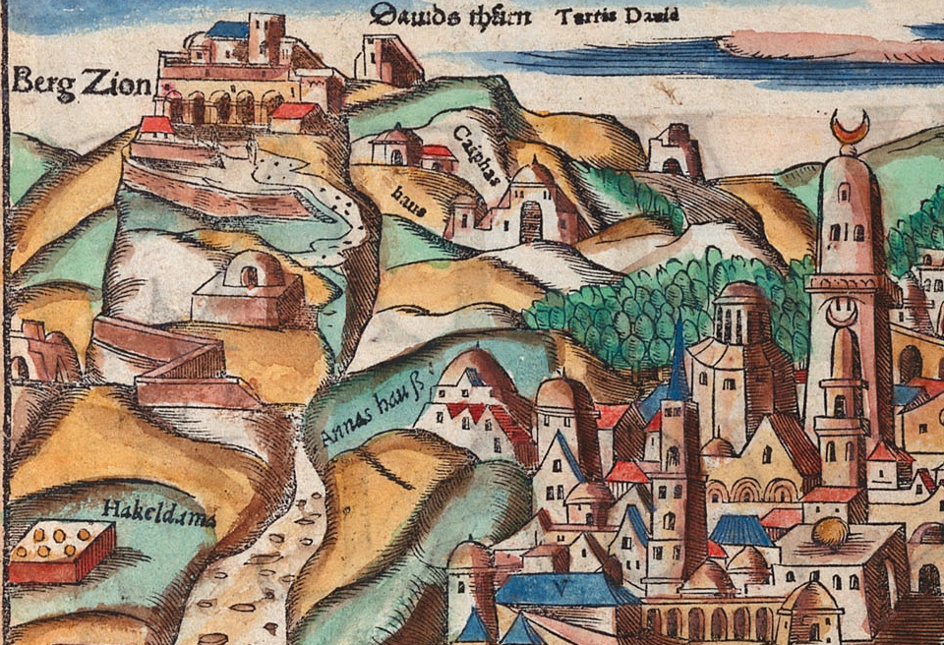
[Monte Sion]
Sebastian Münster (1550)
Historic Cities Center, Hebrew University of Jerusalem

Slide 13
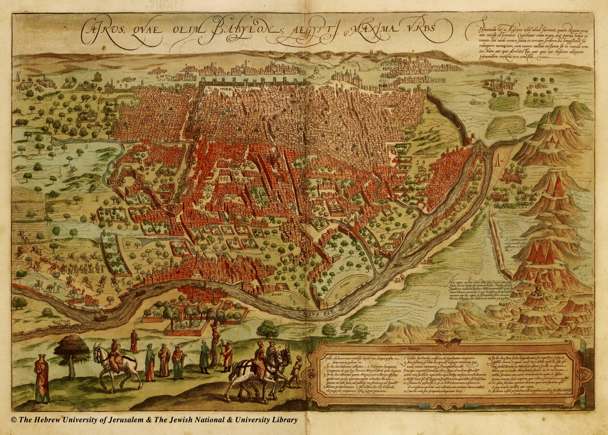
[El Cairo]
Braun & Hogenberg, Civitates Orbis Terrarum (1575)
Historic Cities Center, Hebrew University of Jerusalem

Slide 14
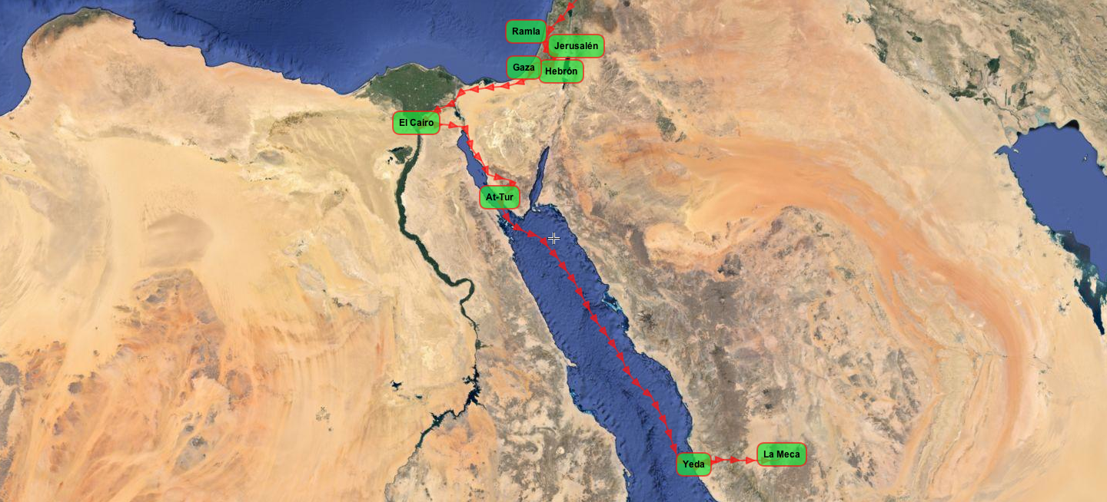

Slide 15
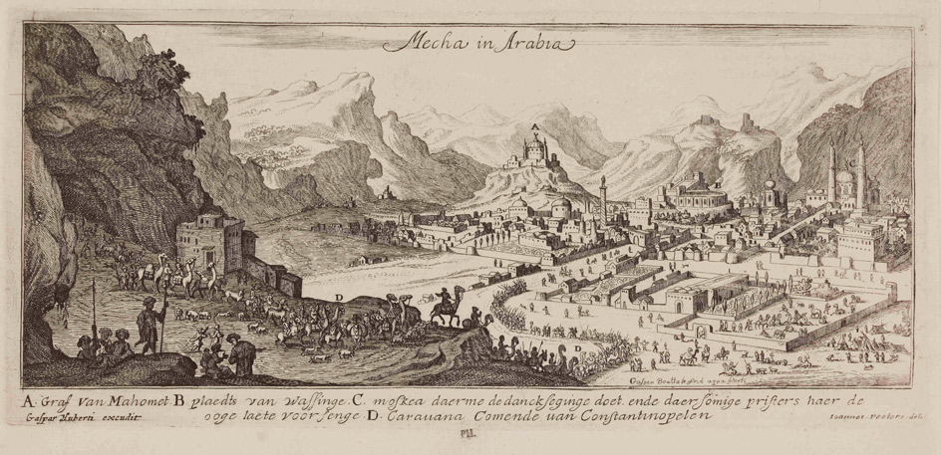
[La Meca]
Gaspar Bouttats after Jan Peeters (1672)
British Museum

Slide 16
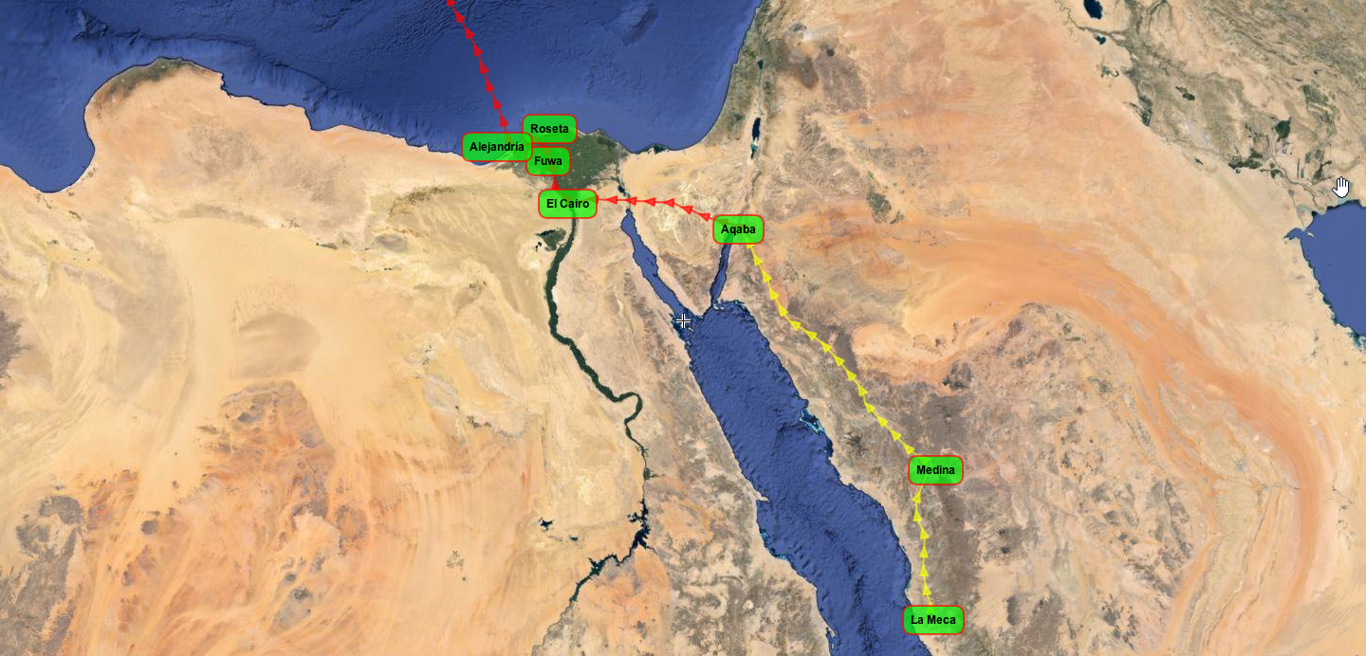

Slide 17
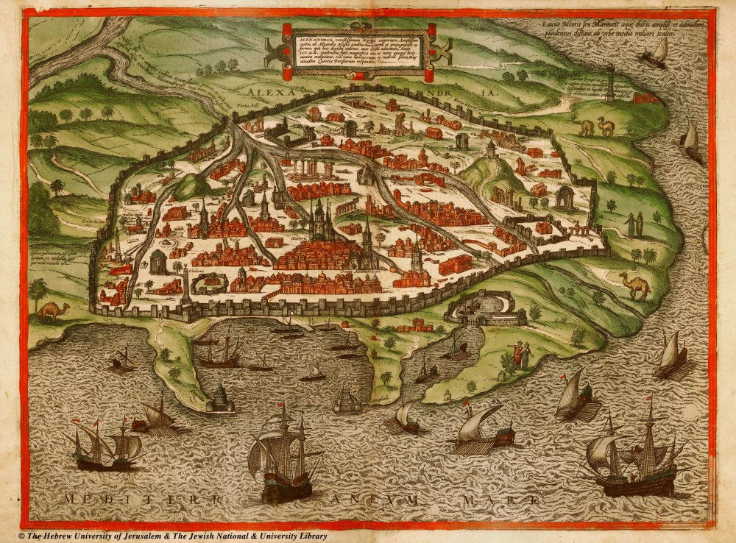
[Alejandría]
Braun & Hogenberg, Civitates Orbis Terrarum (1575)
Historic Cities Center, Hebrew University of Jerusalem

Slide 18
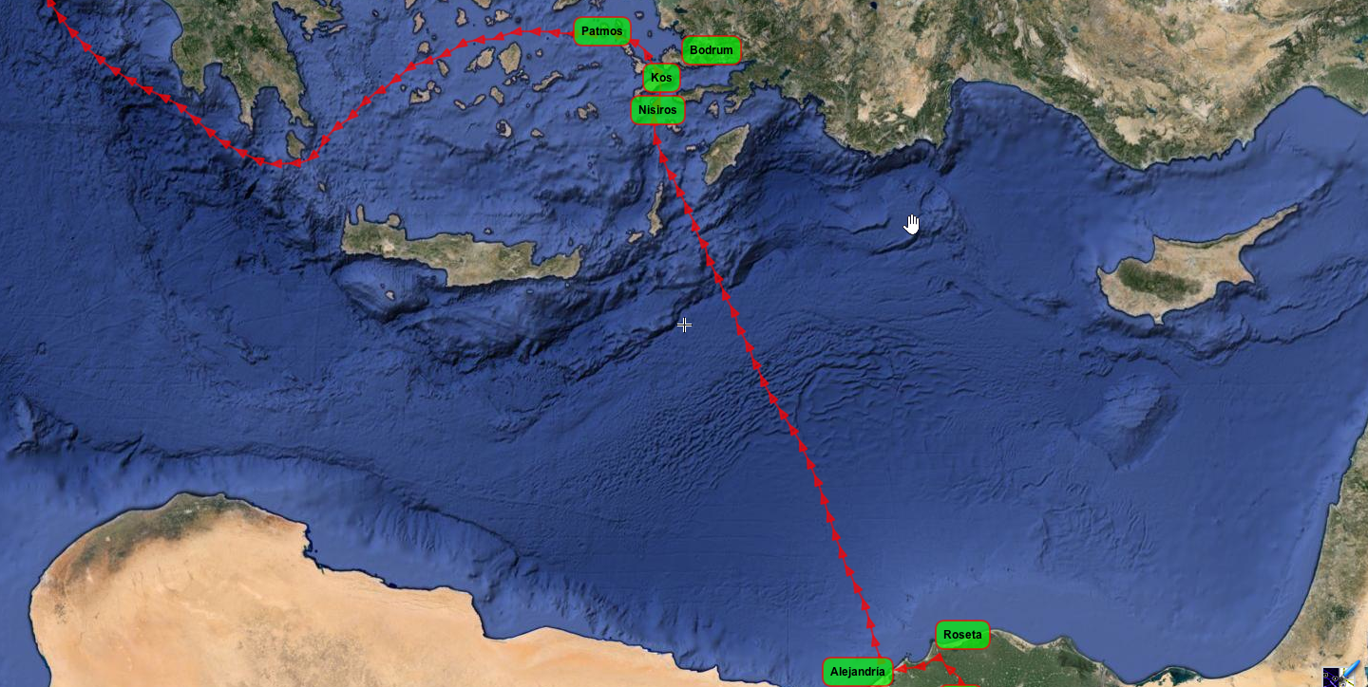

Slide 19
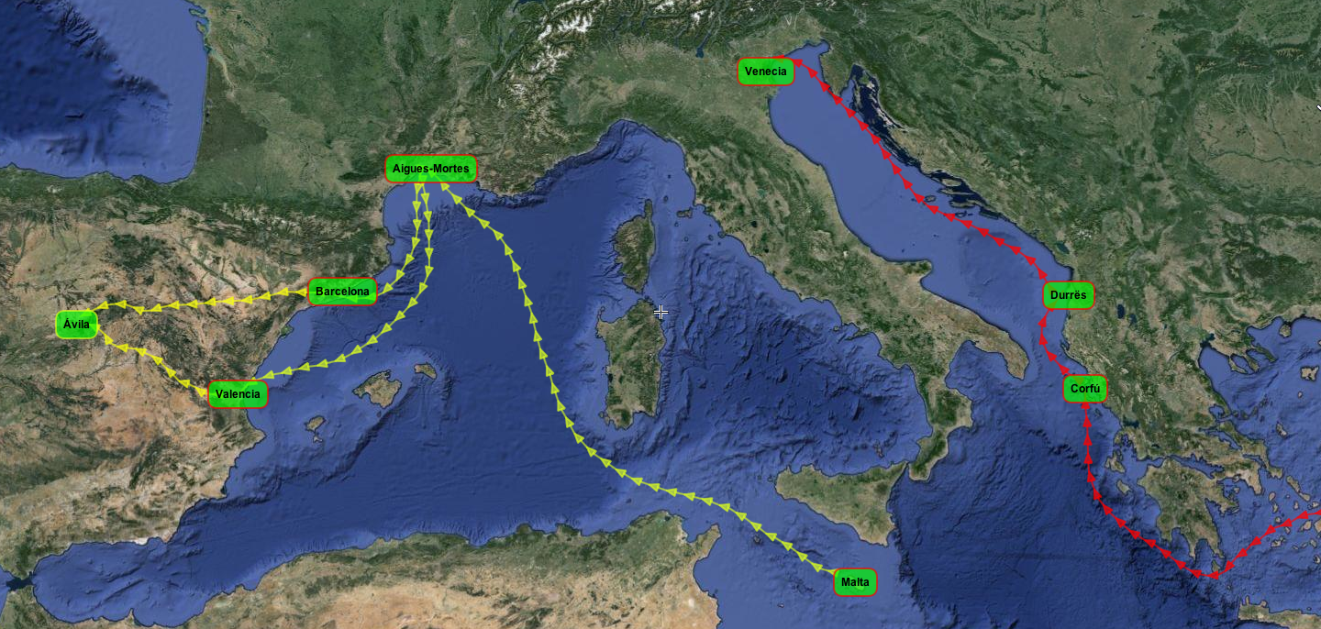

Slide 20
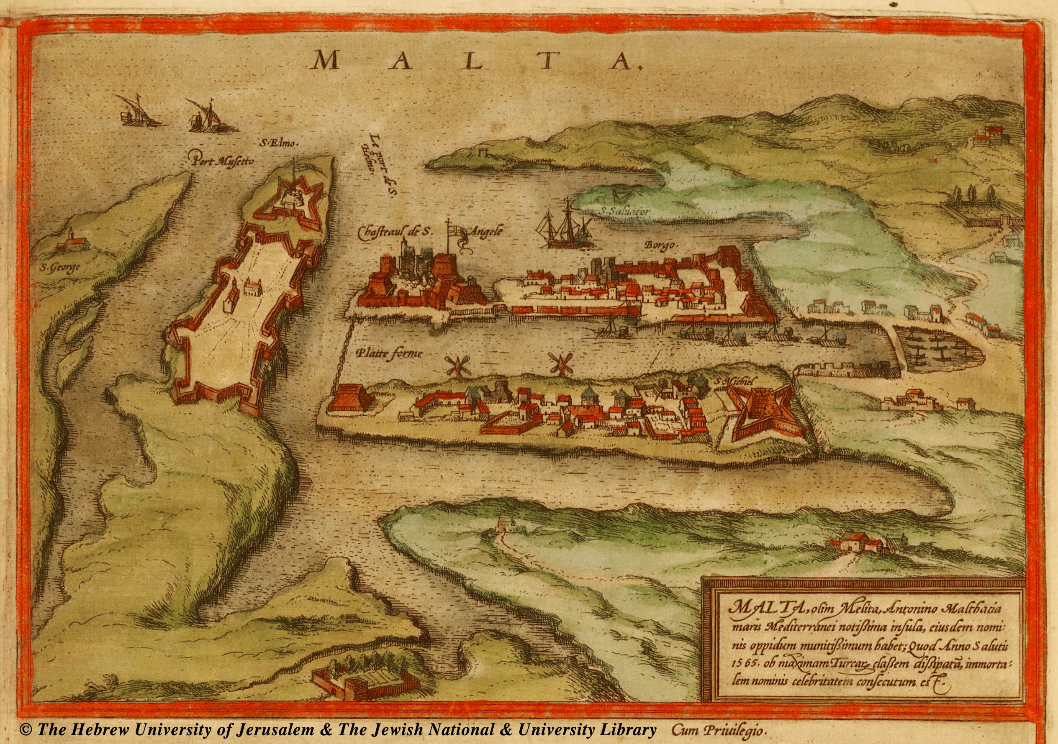
[La Valeta]
Braun & Hogenberg, Civitates Orbis Terrarum (1575)
Historic Cities Center, Hebrew University of Jerusalem

